Slide 1
Epidemiology:
1% of the population has Schizophrenia.
50% of the population may attempt suicide → 10% will die
Presentation: 4 A’s
Ambivalence
Affect
Loose Association
Autism
Positive Vs Negative Symptoms
“Positive symptoms have traditionally attracted the most attention and are the ones most improved by antipsychotics. However, negative symptoms and impairment in cognition are more closely associated with poor psychosocial function. Negative symptoms and cognitive impairment can be more closely associated with prefrontal lobe dysfunction and positive symptoms with temporolimbic abnormalities. Many patients demonstrate both positive and negative symptoms.”
Positive: Hallucinations, paranoia, delusions
Negative: poor social skills
Mental health act
201 walk in voluntarily but in order to leave, they must have a 72 hour notice before leaving
302 keeps pt in psych hospital for 5 days
303 keeps pt in psych hospital for 20 days

Slide 2
Drug Second Gen Antipsychotics
Risperidone (schitzo only) | Less common EPS than FGA
Ziprasidone | Less common EPS than FGA
Aripiprazole | Less common EPS than FGA
Quetiapine | Metabolic Syndrome: get fat Sedation
Olanzapine (old-lazapine) | Black Box: Mortality in elderly Metabolic Syndrome: get fat Sedation
Clozapine Good in pts with suicide (closet for last resort) | Use if failed 3 other agents b/c of Safety Check ANC > 1500 b/c agranulocytosis weekly q3weeks, then q2w for 6 weeks then monthly 6 months for life
Class (FGA) first-generation antipsychotics | Drug
Phenothiazine | Chlorpromazine Thioridazine Prochlorperazine
Butyrophenone | Haloperidol
Thioxanthenes | N/A
Reason why it’s not First Line:
Not first line because of 1. Extrapyramidal Side Effects 2. Neuroleptic Malignant Syndrome

Slide 3



Extrapyramidal Reactions:
1. Pseudo-Parkinsonism: Balance between DA and ACh.
Drug causes increase in ACh → Parkinson's
2. Akathisia: I can’t sit still
3. Tardive Dyskinesia aka “bucco-linguo-masticatory syndrome”: ‘tongue fly catching”
4. Acute Dystonia: neurological movement disorder
Acute Dystonia
Torticollis: twist neck
Retrocollis
head is drawn back
Oculogyric
Eyes rolled back

Slide 4
Extrapyramidal Treatment:
Benztropine (Cogentin) 1 mg PO BID
Keep side effect from coming back
usually withdraw in a few weeks
only 1 out of 4 need it chronically
Diphenhydramine (not used chronically b/c of sedation)
Relief is typically seen within 15 to 20 minutes of an intramuscular injection and within 5 minutes of intravenous administration
More DA = Parkinson's
Less ACh = Parkinson’s
ACh
DA
Neuroleptic Malignant Syndrome (NMS)
More common with First generation antipsychotics
S/S: muscle Rigidity → increase creatine kinase
Fatal in 10 – 15% of cases
Treatment should begin with antipsychotic discontinuation and supportive care.

Slide 5
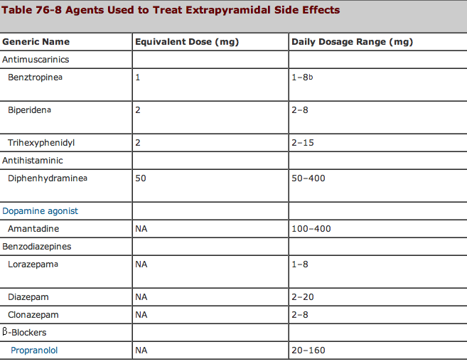

Slide 6
